Slide 1
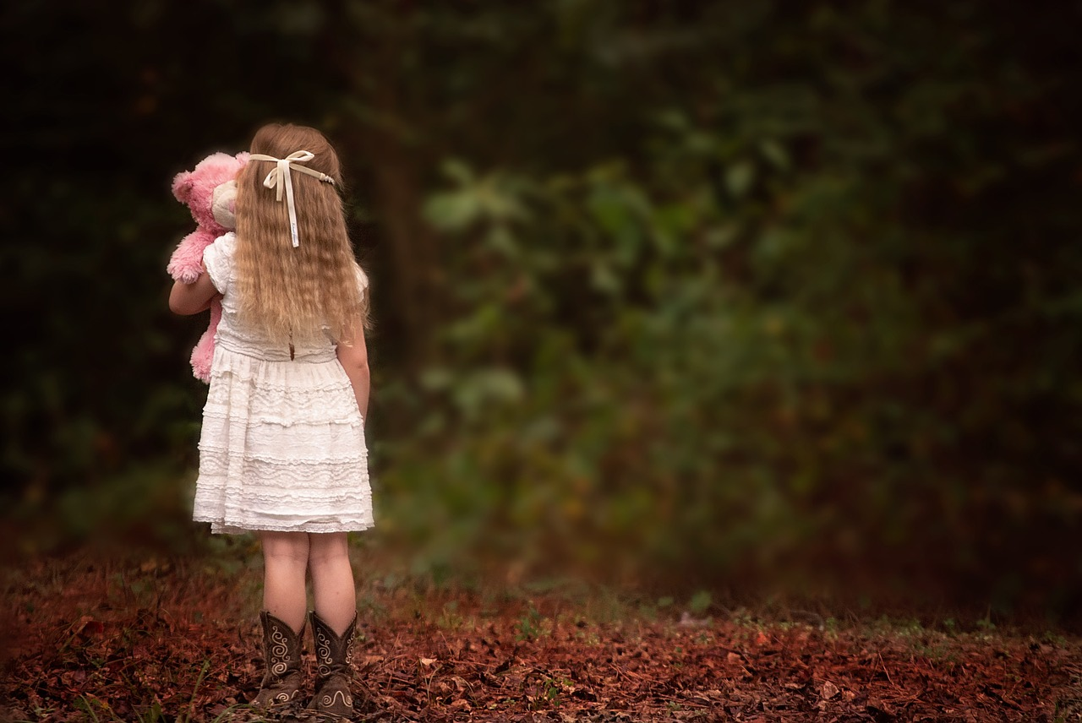
Come Just As You Are (For You I Am Praying) 以你本相前來 (我在為你禱告)

Slide 2
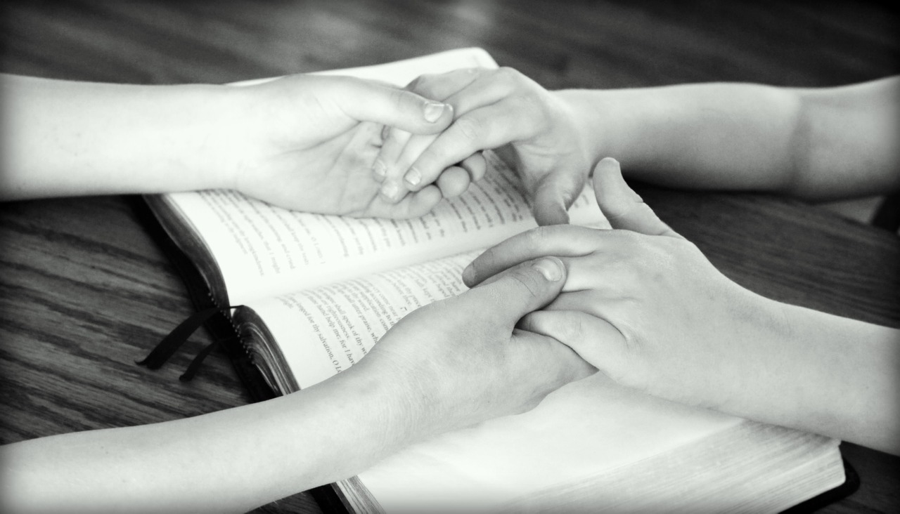
Someone is praying for you,
I am praying for you.
有人在為你禱告、
我在為你禱告

Slide 3
This great God you may know not,
But He has always loved you.
這位偉大真神，
你或許不識，
但祂永遠愛你。

Slide 4
Come just as you are,
hear the spirit call.
以你本相前來，
聆聽聖靈呼喚。

Slide 5
Come just as you are,
come and see,
come receive,
come and live for ever.
以你本相前來，
來觀看、來領受、
來得著永生。

Slide 6
Come just as you are,
hear the spirit call.
以你本相前來，
聆聽聖靈呼喚。

Slide 7
Come just as you are,
come and see,
come receive,
come and live forever more.
以你本相前來，
來觀看、來領受、
來得著永生。

Slide 8
I have a Saviour, He’s pleading in glory,
a dear loving Saviour,
though earth friends be few.
我有一位救主、祂在榮耀中代禱
一位慈愛救主，雖然朋友少。

Slide 9
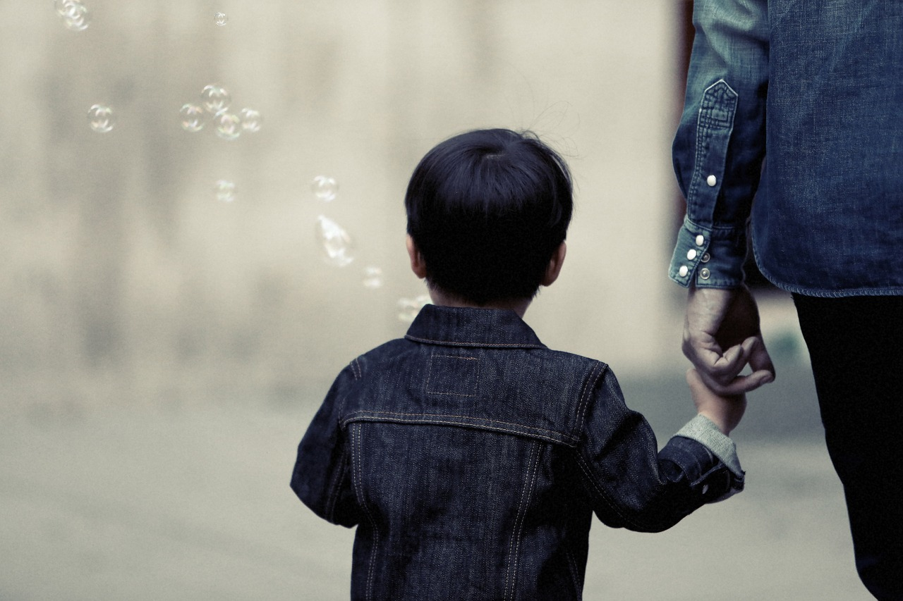
And how He is watching
in tenderness over me,
and oh that my Saviour
were your Saviour too.
他用慈愛眼光，一輩子看顧我，
祂是我的救主，祂也是你主。

Slide 10
For you I am praying,
for you I am praying,
For you I am praying,
I’m praying for you.
我在為你代禱，我在為你代禱。
我在為你代禱，我在為你禱告。

Slide 11
Nye ninging’ Imana ngw ikwereke Yesu,
Ng’umwakire nawe ni ko ngusabira
For you I am praying, for you I am praying,
For you I am praying, I’m praying for you.
我在為你代禱，我在為你代禱。
我在為你代禱，我在為你禱告。

Slide 12
Nahaw ikibanza na Data wo mw’ijuru,
Mu rugo rwe wera kub’g Umwana we.
I have a Father, to me He has given a hope for eternity, blessed and true.
我有一天父，祂給我永恆希望
也給我永恆祝福及真誠。

Slide 13
Azangezayo ngo tuban’ iteka ryose,
Ichyampa ngo nawe tuzabaneyo.
Oh when I receive it all shining in brightness, dear friend could I see you receiving one too.
當我在光明中領受這些祝福，
親愛的朋友，你也有你的福。

Slide 14
Nye ninging’ Imana ngw ikwereke Yesu,
Ng’umwakire nawe ni ko ngusabira
For you I am praying, for you I am praying,
For you I am praying, I’m praying for you.
我在為你代禱，我在為你代禱。
我在為你代禱，為你我禱告。

Slide 15
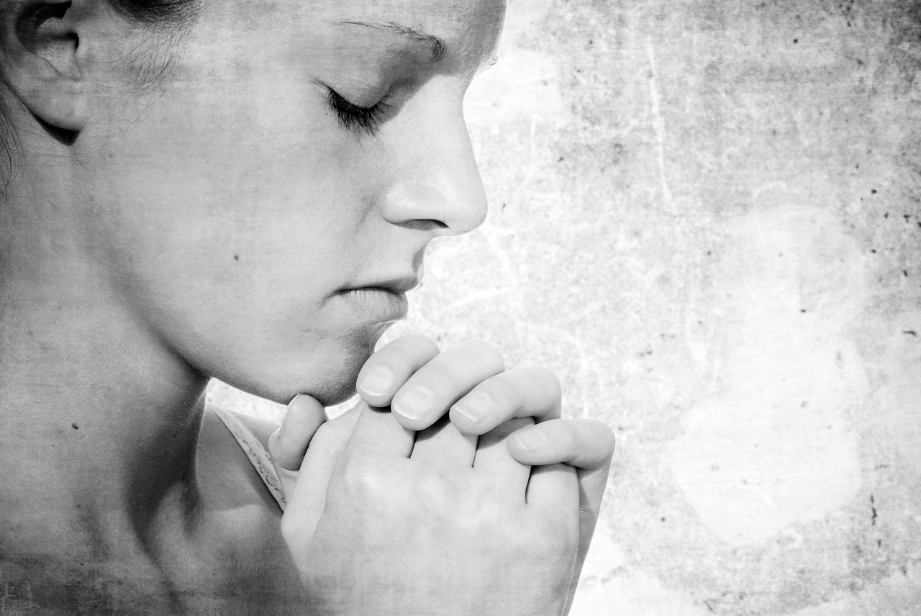
For you I am praying,
I’m praying for you.
我在為你代禱，
為你我禱告。

